Slide 1
Data Link
Control
Topic
Access Control
Flow Control
Error Control

Slide 2
Learning Outcome
Explain the importance of protocol and data link control (A3)
How how the access control being done(P2)
Show how the flow control being done(P2)

Slide 3
Introduction
The most important functions in the data link layer are:
  Access Control – determines which who can send and when
  Flow control – coordinates the amount of data that can be sent
  Error control – perform error detection and correction

Slide 4
MAC Protocols: A taxonomy
Three broad classes:
Channel Partitioning
  divide channel into smaller “pieces” (time slots, frequency) using FDM,WDM or TDM
Random Access
  channel not divided, allow collisions
  “recover” from collisions
“Taking turns”/Polling
  nodes take turns, but nodes with more to send can take longer turns

Slide 5
Channel Partitioning
TDMA: time division multiple access
access to channel in "rounds"
each station gets fixed length slot (length = pkt trans time) in each round
unused slots go idle
example: 6-station LAN, 1,3,4 have pkt, slots 2,5,6 idle
6-slot
frame
3
3
4
1
4
1
Notes:
https://www.youtube.com/watch?v=v9t8v6XcGqU
Figure here is good.
Technology
https://searchnetworking.techtarget.com/definition/TDMA

Slide 6
Random Access Protocols
When node has packet to send
  transmit at full channel data rate R.
  no a priori coordination among nodes
two or more transmitting nodes ➜ “collision”
random access MAC protocol specifies:
  how to detect collisions
  how to recover from collisions
  Examples protocols: slotted ALOHA, ALOHA, CSMA, CSMA/CD, CSMA/CA

Slide 7
ALOHA
Developed for packet radio nets
When station has frame, it sends
Then listens for a bit over max round trip time
  if receive ACK then fine
  if not, retransmit
  if no ACK after repeated transmissions, give up
frame may be damaged by noise or collision
Notes:
The earliest of these techniques, known as ALOHA, was developed for packet radio networks. However, it is applicable to any shared transmission medium. ALOHA, or pure ALOHA as it is sometimes called, specifies that a station may transmit a frame at any time. The station then listens for an amount of time equal to the maximum possible round-trip propagation delay on the network (twice the time it takes to send a frame between the two most widely separated stations) plus a small fixed time increment. If the station hears an acknowledgment during that time, fine; otherwise, it resends the frame. If the station fails to receive an acknowledgment after repeated transmissions, it gives up. A receiving station determines the correctness of an incoming frame by examining a frame check sequence field, as in HDLC. If the frame is valid and if the destination address in the frame header matches the receiver's address, the station immediately sends an acknowledgment. The frame may be invalid due to noise on the channel or because another station transmitted a frame at about the same time. In the latter case, the two frames may interfere with each other at the receiver so that neither gets through; this is known as a collision. If a received frame is determined to be invalid, the receiving station simply ignores the frame. ALOHA is as simple as can be, and pays a penalty for it. Because the number of collisions rises rapidly with increased load, the maximum utilization of the channel is only about 18%.

Slide 8

Figure 12.3 Frames in a pure ALOHA network

Slide 9

Figure 12.4 Procedure for pure ALOHA protocol

Slide 10
Slotted ALOHA
Assumptions:
all frames same size
time divided into equal size slots (time to transmit 1 frame)
nodes start to transmit only slot beginning
nodes are synchronized
if 2 or more nodes transmit in slot, all nodes detect collision
Operation:
when node obtains fresh frame, transmits in next slot
  if no collision: node can send new frame in next slot
  if collision: node retransmits frame in each subsequent slot with probability p

Slide 11

Slotted ALOHA
Pros
single active node can continuously transmit at full rate of channel
highly decentralized: nodes decides independently
simple
Cons
collisions, wasting slots
idle slots
clock synchronization
Notes:
https://www.tutorialspoint.com/computer_networks/aloha_random_access_protocol.asp
Pure aloha vs slotted aloha.. How to put the frame into slot

Slide 12
CSMA (Carrier Sense Multiple Access)
stations soon know transmission has started
so first listen for clear medium (carrier sense)
if medium idle, transmit
if two stations start at the same instant, collision
  wait reasonable time
  if no ACK then retransmit
Notes:
The foregoing observations led to the development of carrier sense multiple access (CSMA). With CSMA, a station wishing to transmit first listens to the medium to determine if another transmission is in progress (carrier sense). If the medium is in use, the station must wait. If the medium is idle, the station may transmit. It may happen that two or more stations attempt to transmit at about the same time. If this happens, there will be a collision; the data from both transmissions will be garbled and not received successfully. To account for this, a station waits a reasonable amount of time after transmitting for an acknowledgment, taking into account the maximum round-trip propagation delay and the fact that the acknowledging station must also contend for the channel to respond. If there is no acknowledgment, the station assumes that a collision has occurred and retransmits. This strategy is effective for networks in which the average frame transmission time is much longer than the propagation time. Collisions can occur only when more than one user begins transmitting within a short time interval (the period of the propagation delay). If a station begins to transmit a frame, and there are no collisions during the time it takes for the leading edge of the packet to propagate to the farthest station, then there will be no collision for this frame because all other stations are now aware of the transmission. The maximum utilization achievable using CSMA can far exceed that of ALOHA or slotted ALOHA. The maximum utilization depends on the length of the frame and on the propagation time; the longer the frames or the shorter the propagation time, the higher the utilization.

Slide 13
CSMA/CD Description
CSMA/CD rules:
  if medium idle, transmit
  if busy, listen for idle, then transmit
  if collision detected, transmit jam signal and then stop transmission(backoff), wait random time then retry
  Use by Ethernet
Notes:
CSMA, although more efficient than ALOHA or slotted ALOHA, still has one glaring inefficiency. When two frames collide, the medium remains unusable for the duration of transmission of both damaged frames. For long frames, compared to propagation time, the amount of wasted capacity can be considerable. This waste can be reduced if a station continues to listen to the medium while transmitting. This leads to the following rules for CSMA/CD:
1. If the medium is idle, transmit; otherwise, go to step 2.
2. If the medium is busy, continue to listen until the channel is idle, then transmit immediately.
3. If a collision is detected during transmission, transmit a brief jamming signal to assure that all stations know that there has been a collision and then cease transmission.
4. After transmitting the jamming signal, wait a random amount of time, referred to as the backoff, then attempt to transmit again (repeat from step 1).
https://en.wikipedia.org/wiki/Carrier-sense_multiple_access

Slide 14
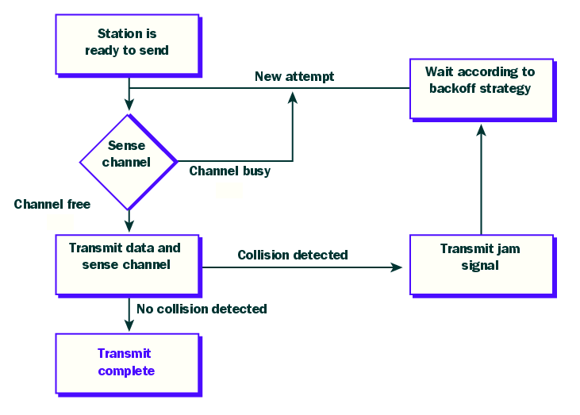
CSMA/CD
(2)
(1)
(3)

Slide 15
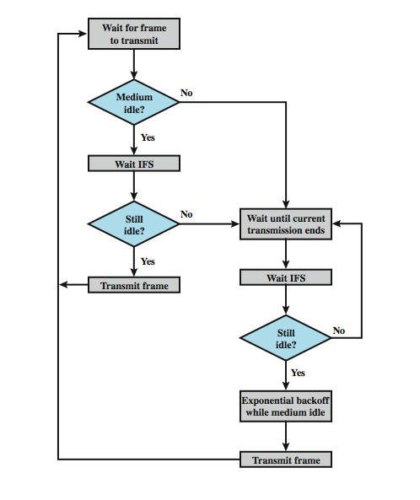
IEEE 802.11 MAC Protocol
CSMA/CA
IFS : Inter Frame Spacing
Notes:
To avoid collision = use interframe space.
Deffering transmission even the channel is idle

Slide 16
CSMA/CA Description
CSMA/CA rules:
  if medium idle, (not send directly) wait for some IFS time, then sense the channel
    If busy – go to step 2
    If still idle – transmit a frame(but wait for contention window time)
  if busy, wait until transmission end and then wait for some IFS time, then sense the channel again
    If busy – go to Step 2
    If idle – backoff/wait for some random time and transmit a frame
    CSMA/CA is used by Wi-Fi
Notes:
CSMA, although more efficient than ALOHA or slotted ALOHA, still has one glaring inefficiency. When two frames collide, the medium remains unusable for the duration of transmission of both damaged frames. For long frames, compared to propagation time, the amount of wasted capacity can be considerable. This waste can be reduced if a station continues to listen to the medium while transmitting. This leads to the following rules for CSMA/CD:
1. If the medium is idle, transmit; otherwise, go to step 2.
2. If the medium is busy, continue to listen until the channel is idle, then transmit immediately.
3. If a collision is detected during transmission, transmit a brief jamming signal to assure that all stations know that there has been a collision and then cease transmission.
4. After transmitting the jamming signal, wait a random amount of time, referred to as the backoff, then attempt to transmit again (repeat from step 1).

Slide 17

“Taking Turns” MAC protocols
Polling:
master node “invites” slave nodes to transmit in turn
data
poll
master
data
slaves

Slide 18
“Taking Turns”
MAC protocols
T
Token passing:
control token passed from one node to next sequentially.
(nothing
to send)
T
data

Slide 19
Summary of Access Control
channel partitioning, by time, frequency or code
  Time Division, Frequency Division
random access (dynamic),
  ALOHA, S-ALOHA, CSMA, CSMA/CD
  carrier sensing: easy in some technologies (wire), hard in others (wireless)
  CSMA/CD used in Ethernet
  CSMA/CA used in 802.11
taking turns
  polling from central site, token passing
  Bluetooth, FDDI, IBM Token Ring

Slide 20
Flow Control
Procedures that tells the sender how much data to transmit.
Each receiving device has a block of memory.
Two methods
  Stop-and-wait
  Sliding window

Slide 21
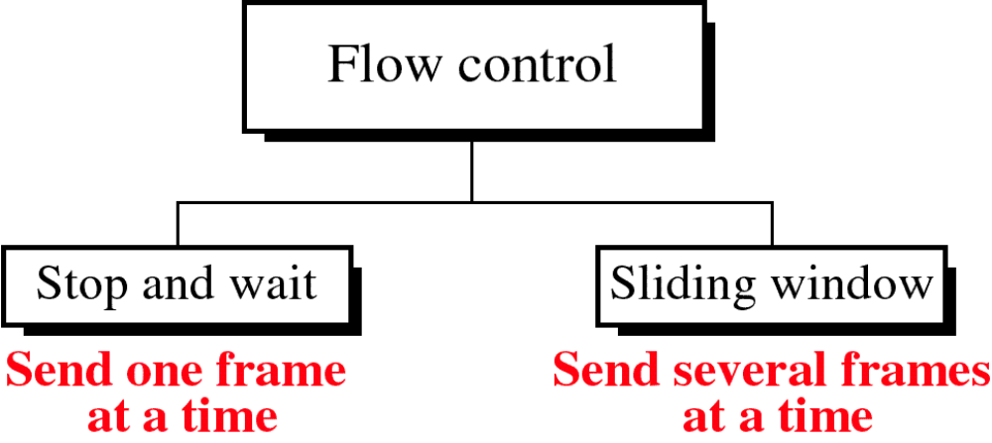

Slide 22
Stop and Wait
source transmits frame
destination receives frame and replies with acknowledgement (ACK)
source waits for ACK before sending next
destination can stop flow by not send ACK
works well for a few large frames
Stop and wait becomes inadequate if large block of data is split into small frames
Notes:
The simplest form of flow control, known as stop-and-wait flow control, works as follows. A source entity transmits a frame. After the destination entity receives the frame, it indicates its willingness to accept another frame by sending back an acknowledgment to the frame just received. The source must wait until it receives the acknowledgment before sending the next frame. The destination can thus stop the flow of data simply by withholding acknowledgment. This procedure works fine and, indeed, can hardly be improved upon when a message is sent in a few large frames. However, it is often the case that a source will break up a large block of data into smaller blocks and transmit the data in many frames (because of limited buffer size, errors detected sooner with less to resend, to prevent media hogging). With the use of multiple frames for a single message, the stop-and-wait procedure may be inadequate, mainly since only one frame at a time can be in transit.

Slide 23
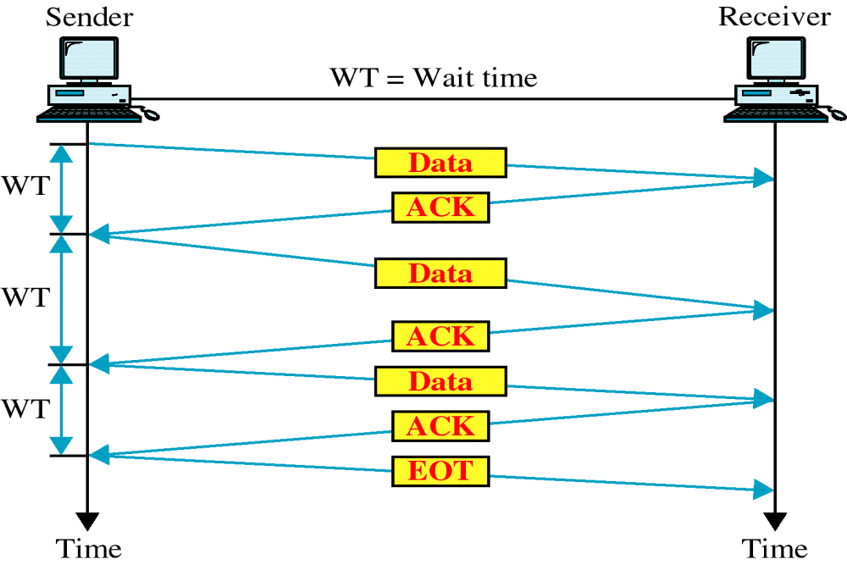
Stop and Wait
Link Utilization
Notes:
With the use of multiple frames for a single message, the stop-and-wait procedure may be inadequate, mainly since only one frame at a time can be in transit.
To show this, start by defining the bit length B of a link as the number of bits present on the link at an instance in time when a stream of bits fully occupies the link. In situations where the bit length of the link is greater than the frame length, serious inefficiencies result, as shown in Stallings DCC8e Figure 7.2. In the figure, the transmission time (the time it takes for a station to transmit a frame) is normalized to one, and the propagation delay (the time it takes for a bit to travel from sender to receiver) is expressed as the variable a = B / L (where L is the number of bits in the frame).
When a is less than 1, the propagation time is less than the transmission time. In this case, the frame is sufficiently long that the first bits of the frame have arrived at the destination before the source has completed the transmission of the frame. When a is greater than 1, the propagation time is greater than the transmission time. In this case, the sender completes transmission of the entire frame before the leading bits of that frame arrive at the receiver. Both parts of Figure 7.2 (a and b) consist of a sequence of snapshots, the first four show the process of transmitting a data frame, and the last shows the return of a small acknowledgment frame. Note that for a > 1, the line is always underutilized and even for a < 1, the line is inefficiently utilized. In essence, for very high data rates, for very long distances between sender and receiver, stop-and-wait flow control provides inefficient line utilization.

Slide 24
Sliding Windows
Flow Control
allows multiple numbered frames to be in transit
receiver has buffer W long
transmitter sends up to W frames without ACK
ACK includes number of next frame expected
sequence number is bounded by size of field (k)
  frames are numbered modulo 2^{k}
  giving max window size of up to 2^{k} - 1
receiver can ack frames without permitting further transmission (Receive Not Ready)
must send a normal acknowledge to resume
if have full-duplex link, can piggyback ACks
Notes:
The essence of the problem described so far is that only one frame at a time can be in transit. Efficiency can be greatly improved by allowing multiple frames to be in transit at the same time. Consider two stations, A and B, connected via a full-duplex link. Station B allocates buffer space for W frames. Thus, B can accept W frames, and A is allowed to send W frames without waiting for any acknowledgments. To keep track of which frames have been acknowledged, each is labeled with a a k-bit sequence number. This gives a range of sequence numbers of 0 through 2^{k} – 1, and frames are numbered modulo 2^{k}, with a maximum window size of 2^{k} – 1. The window size need not be the maximum possible size for a given sequence number length k. B acknowledges a frame by sending an acknowledgment that includes the sequence number of the next frame expected. This scheme can also be used to acknowledge multiple frames, and is referred to as sliding-window flow control. Most data link control protocols also allow a station to cut off the flow of frames from the other side by sending a Receive Not Ready (RNR) message, which acknowledges former frames but forbids transfer of future frames. At some subsequent point, the station must send a normal acknowledgment to reopen the window. If two stations exchange data, each needs to maintain two windows, one for transmit and one for receive, and each side needs to send the data and acknowledgments to the other. To provide efficient support for this requirement, a feature known as piggybacking is typically provided. Each data frame includes a field that holds the sequence number of that frame plus a field that holds the sequence number used for acknowledgment.

Slide 25
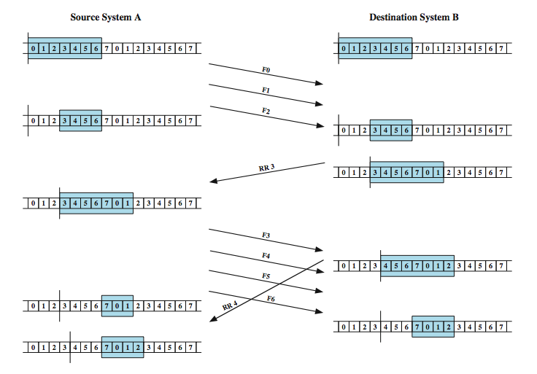
Sliding Window Example
Notes:
An example is shown in Stallings DCC8e Figure 7.4. The example assumes a 3-bit sequence number field and a maximum window size of seven frames. Initially, A and B have windows indicating that A may transmit seven frames, beginning with frame 0 (F0). After transmitting three frames (F0, F1, F2) without acknowledgment, A has shrunk its window to four frames and maintains a copy of the three transmitted frames. The window indicates that A may transmit four frames, beginning with frame number 3. B then transmits an RR (receive ready) 3, which means "I have received all frames up through frame number 2 and am ready to receive frame number 3; in fact, I am prepared to receive seven frames, beginning with frame number 3." With this acknowledgment, A is back up to permission to transmit seven frames, still beginning with frame 3; also A may discard the buffered frames that have now been acknowledged. A proceeds to transmit frames 3, 4, 5, and 6.
B returns RR 4, which acknowledges F3, and allows transmission of F4 through the next instance of F2. By the time this RR reaches A, it has already transmitted F4, F5, and F6, and therefore A may only open its window to permit sending four frames beginning with F7.

Slide 26
Error Control
- Refers to methods of error detection and correction due to
  lost frames
  damaged frames
- common techniques use:
  error detection (CRC,checksum)
  positive acknowledgment
  retransmission after timeout
  negative acknowledgement & retransmission

Slide 27
Automatic Repeat Request (ARQ)
collective name for such error control mechanisms, including:
stop and wait
go back N
selective repeat (selective retransmission)

Slide 28
Stop and Wait
source transmits single frame
wait for ACK
if received damaged frame, discard it
  no ACK received
  if no ACK within timeout, retransmit
if ACK damaged, transmitter will not recognize it
  transmitter will retransmit
  receiver gets two copies of frame
  use alternate numbering and ACK0 / ACK1
Notes:
Stop-and-wait ARQ is based on the stop-and-wait flow control technique outlined previously. The source station transmits a single frame and then must await an acknowledgment (ACK). No other data frames can be sent until the destination station's reply arrives at the source station.
Two sorts of errors could occur. First, the frame that arrives at the destination could be damaged. The receiver detects this by using the error-detection technique referred to earlier and simply discards the frame. To account for this possibility, the source station is equipped with a timer. After a frame is transmitted, the source station waits for an acknowledgment. If no acknowledgment is received by the time that the timer expires, then the same frame is sent again. Note that this method requires that the transmitter maintain a copy of a transmitted frame until an acknowledgment is received for that frame.
The second sort of error is a damaged acknowledgment, which is not recognizable by A, which will therefore time out and resend the same frame. This duplicate frame arrives and is accepted by B. B has therefore accepted two copies of the same frame as if they were separate. To avoid this problem, frames are alternately labeled with 0 or 1, and positive acknowledgments are of the form ACK0 and ACK1. In keeping with the sliding-window convention, an ACK0 acknowledges receipt of a frame numbered 1 and indicates that the receiver is ready for a frame numbered 0.

Slide 29

Stop and Wait
see example with both types of errors
pros and cons
  simple
  inefficient
Notes:
Stallings DCC8e Figure 7.5 gives an example of the use of stop-and-wait ARQ, showing the transmission of a sequence of frames from source A to destination B. The figure shows the two types of errors just described. The third frame transmitted by A is lost or damaged and therefore B does not return an ACK. A times out and retransmits the frame.
Later, A transmits a frame labeled 1 but the ACK0 for that frame is lost. A times out and retransmits the same frame. When B receives two frames in a row with the same label, it discards the second frame but sends back an ACK0 to each.
The principal advantage of stop-and-wait ARQ is its simplicity. Its principal disadvantage is that stop-and-wait is an inefficient mechanism.

Slide 30
Go-Back-N
based on sliding window
if no error, ACK as usual
use window to control number of outstanding frames
if error, negative acknowledgment
  discard that frame and all future frames until error frame received correctly
  transmitter must go back and retransmit that frame and all subsequent frames
Notes:
The sliding-window flow control technique can be adapted to provide more efficient line use, sometimes referred to as continuous ARQ. The form of error control based on sliding-window flow control that is most commonly used is called go-back-N ARQ. In this method, a station may send a series of frames sequentially numbered modulo some maximum value. The number of unacknowledged frames outstanding is determined by window size, using the sliding-window flow control technique. While no errors occur, the destination will acknowledge incoming frames as usual (RR = receive ready, or piggybacked acknowledgment). If the destination station detects an error in a frame, it may send a negative acknowledgment (REJ = reject) for that frame, as explained in the following rules. The destination station will discard that frame and all future incoming frames until the frame in error is correctly received. Thus, the source station, when it receives a REJ, must retransmit the frame in error plus all succeeding frames that were transmitted in the interim.

Slide 31
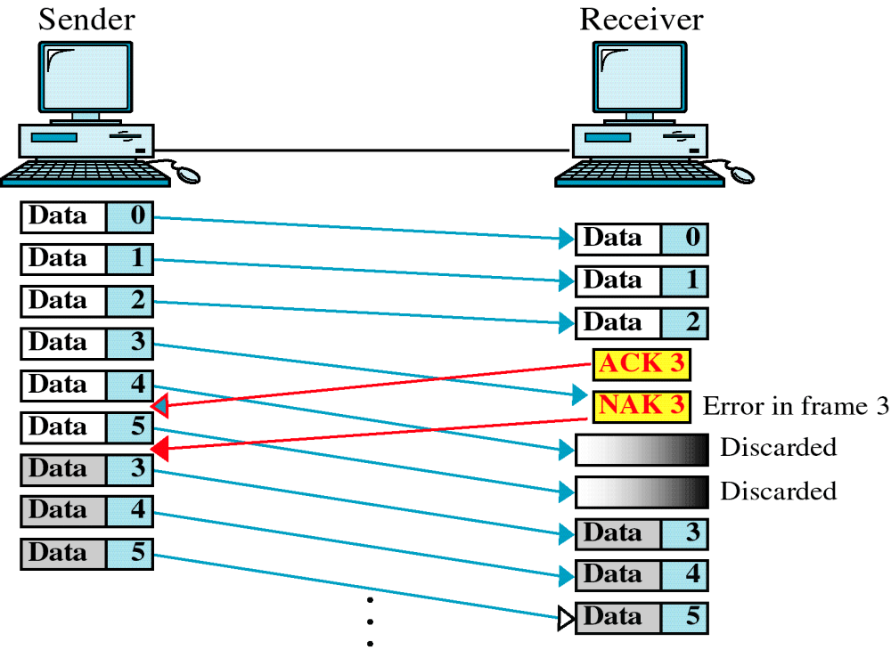
Damaged Frame

Slide 32
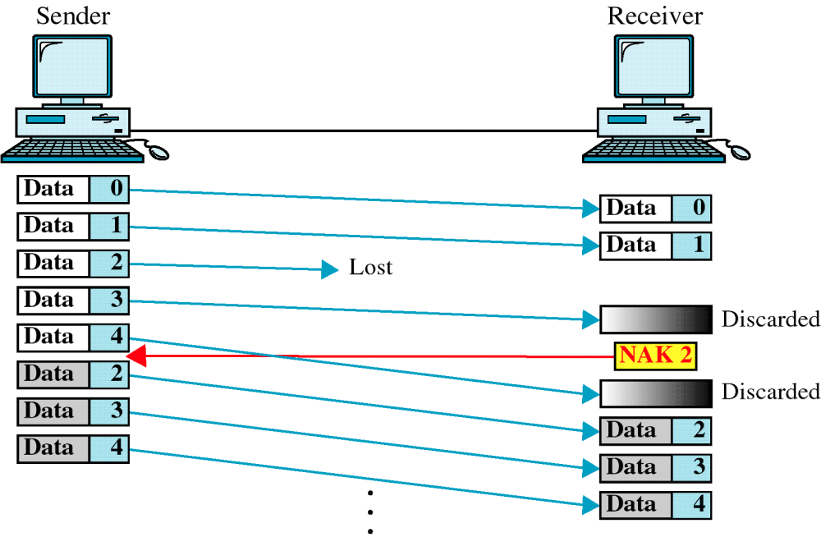
Lost Frame

Slide 33
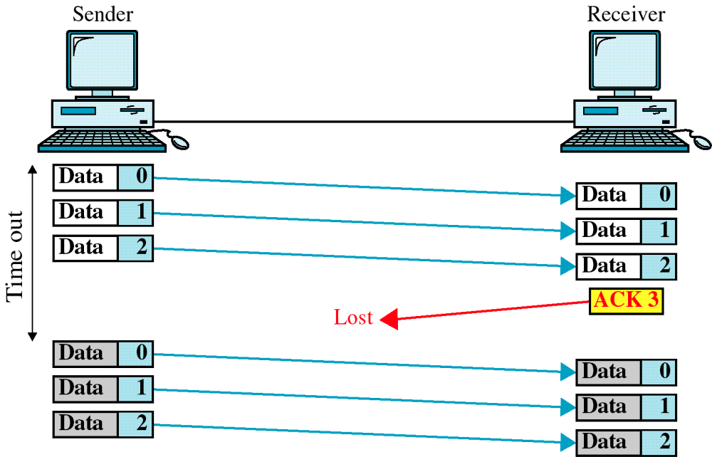
Lost ACK

Slide 34
Selective Repeat
only rejected frames are retransmitted
subsequent frames are accepted by the receiver and buffered
minimizes retransmission
receiver must maintain large enough buffer
more complex logic in transmitter
hence less widely used
useful for satellite links with long propagation delays
Notes:
With selective-reject ARQ, the only frames retransmitted are those that receive a negative acknowledgment, in this case called SREJ, or those that time out. Selective reject would appear to be more efficient than go-back-N, because it minimizes the amount of retransmission. On the other hand, the receiver must maintain a buffer large enough to save post-SREJ frames until the frame in error is retransmitted and must contain logic for reinserting that frame in the proper sequence. The transmitter, too, requires more complex logic to be able to send a frame out of sequence. Because of such complications, select-reject ARQ is much less widely used than go-back-N ARQ. Selective reject is a useful choice for a satellite link because of the long propagation delay involved.

Slide 35
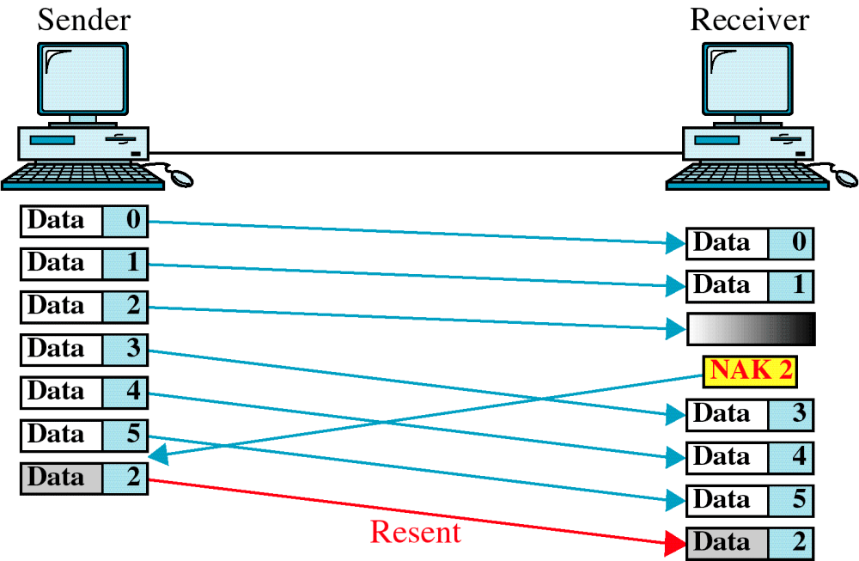
Selective Repeat
Notes:
Stallings DCC8e Figure 7.6a is an example of the frame flow for go-back-N ARQ. Because of the propagation delay on the line, by the time that an acknowledgment (positive or negative) arrives back at the sending station, it has already sent at least one additional frame beyond the one being acknowledged. In this example, frame 4 is damaged. Frames 5 and 6 are received out of order and are discarded by B. When frame 5 arrives, B immediately sends a REJ 4. When the REJ to frame 4 is received, not only frame 4 but frames 5 and 6 must be retransmitted. Note that the transmitter must keep a copy of all unacknowledged frames. Figure 7.6a also shows an example of retransmission after timeout. No acknowledgment is received for frame 5 within the timeout period, so A issues an RR to determine the status of B.
Stallings DCC8e Figure 7.6b illustrates selective-reject ARQ. When frame 5 is received out of order, B sends a SREJ 4, indicating that frame 4 has not been received. However, B continues to accept incoming frames and buffers them until a valid frame 4 is received. At that point, B can place the frames in the proper order for delivery to higher-layer software.

